Slide 1
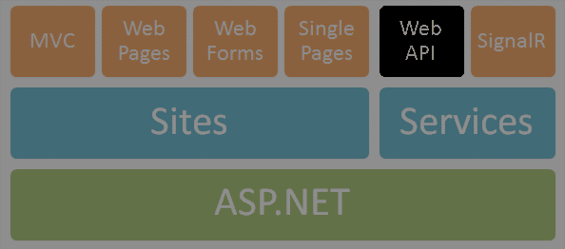
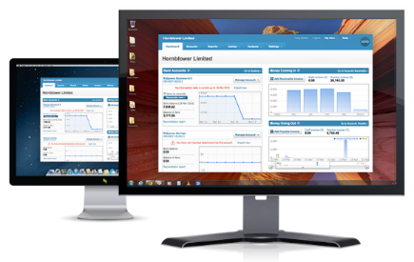




ASP.NET Web API
Web Services and Cloud
Telerik Software Academy
http://academy.telerik.com

Slide 2


Table of Contents
What is ASP.NET Web API?
Web API Features
Demo: Default Project Template
Web API Controllers
Routes
Demo: Create API Controller
OData queries
Web API Clients
Demo: Consuming Web API

Slide 3

What is ASP.NET Web API?

Slide 4
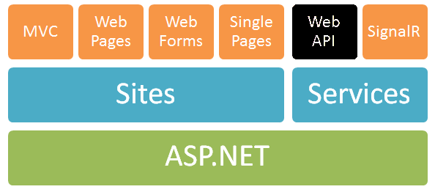
ASP.NET Web API
Framework that makes it easy to build HTTP services for browsers and mobile devices
Platform for building RESTful applications on the .NET Framework using ASP.NET stack

Slide 5



ASP.NET Web API Role
Data storage
XML
HTTP GET
JSON
Data Layer (EF)
ASP.NET Web API
Models
JSON
XML
HTTP PUT, POST, DELETE

Slide 6
Web API Features
Modern HTTP programming model
Access to strongly typed HTTP object model
HttpClient API – same programming model
Content negotiation
Client and server work together to determine the right format for data
Provide default support for JSON, XML and Form URL-encoded formats
We can add own formats and change content negotiation strategy

Slide 7
Web API Features (2)
Query composition
Support automatic paging and sorting
Support querying via the OData URL conventions when we return IQueryable<T>
Model binding and validation
Combine HTTP data in POCO models
Data validation via attributes
Supports the same model binding and validation infrastructure as ASP.NET MVC

Slide 8
Web API Features (3)
Routes (mapping between URIs and code)
Full set of routing capabilities supported within ASP.NET (MVC)
Filters
Easily decorates Web API with additional validation (authorization, CORS, etc.)
Testability
IoC and dependency injection support
Flexible hosting (IIS, Azure, self-hosting)

Slide 9
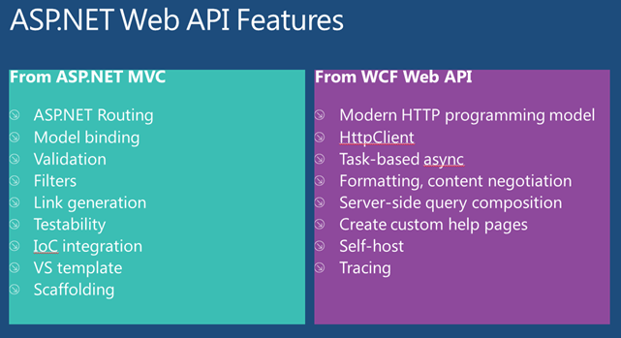
Web API Features (4)
Visual Studio IDE (+templates and scaffolding)
Reuse of C# knowledge (+task-based async)
Custom help pages, tracing, etc.

Slide 10
ASP.NET Web API 2
Attribute routing
OData improvements: $select, $expand, $batch, $value and improved extensibility
Request batching
Portable ASP.NET Web API Client
Improved testability
CORS (Cross-origin resource sharing)
Authentication filters
OWIN support and integration (owin.org)

Slide 11
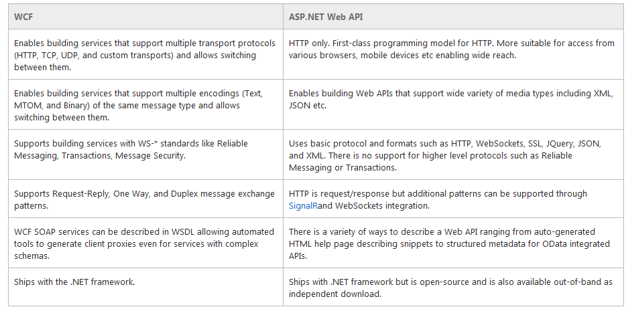
WCF vs. ASP.NET Web API
WCF is also a good framework for building HTTP based services

Slide 12
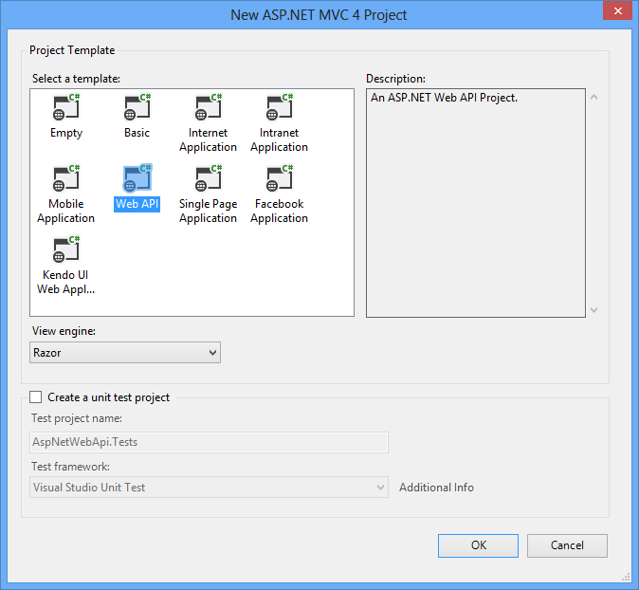
Demo: Creating ASP.NET Web API Project
Default ASP.NET Web API project template

Slide 13

Web API Controllers

Slide 14
Web API Controllers
A controller is an object that handles HTTP requests
All API controllers derive from ApiController
By default ASP.NET Web API will map HTTP requests to specific methods called actions
Action | HTTP method | Relative URI | Method
Get a list of all posts | GET | /api/posts | Get()
Get a post by ID | GET | /api/posts/id | Get(int id)
Create a new post | POST | /api/posts | Post(PostModel value)
Update a post | PUT | /api/posts/id | Put(int id, PostModel value)
Delete a post | DELETE | /api/posts/id | Delete(int id)
Get a post by category | GET | /api/posts?category=category | Get(string category)

Slide 15
Web API Default Behavior
1
2
3
Web Request
Match a Route
API Controller Responds
http://localhost:1337/api/posts
HTTP GET Request
Controller Name
public class PostsController : ApiController
{
public string Get()
{
return "Some data"; }
}

Slide 16
Routing
Routing is how ASP.NET Web API matches a URI to a controller and an action
Web APIs support the full set of routing capabilities from ASP.NET (MVC)
Route parameters
Constraints (using regular expressions)
Extensible with own conventions
Attribute routing is available in version 2

Slide 17
Default Route
Web API also provides smart conventions by default
We can create classes that implement Web APIs without having to explicitly write code
HTTP Verb is mapped to an action name
http://localhost:1337/api/posts
routes.MapHtpRoute(name: "DefaultApi",
routeTemplate: "api/{controller}/{id}",
defaults: new { id = RoutesParameter.Optional });

Slide 18
Model Binding & Formatters
By default the Web API will bind incoming data to POCO (CLR) types
Will look in body, header and query string
ASP.NET MVC has similar model binder
MediaTypeFormatters are used to bind both input and output
Mapped to content types
Validation attributes can also be used
To go down further into the HTTP (set headers, etc.) we can use HttpRequestMessage and HttpResponseMessage

Slide 19
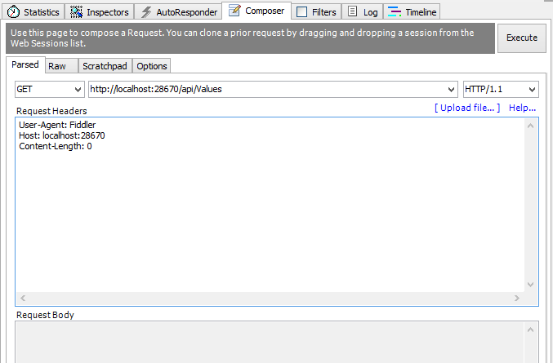
Demo: Create API Controller

Slide 20
Return Different HTTP Code
By default when everything is OK, we return HTTP status code 200
Sometimes we need to return error
public HttpResponseMessage Get(int id)
{
if (dataExists)
{
return Request.CreateResponse( HttpStatusCode.OK, data);
} else
{
return Request.CreateErrorResponse( HttpStatusCode.NotFound, "Item not found!");
} }

Slide 21
OData Query Syntax
OData (http://odata.org) is a open specification written by Microsoft
Provide a standard query syntax on resources
Implemented by WCF Data Services
ASP.NET Web API includes automatic support for this syntax
Return IQueryable<T> instead of IEnumerable<T>

Slide 22
OData Query Syntax
To enable OData queries uncomment "config.EnableQuerySupport();" line
Then we can make OData queries like: "http://localhost/Posts?$top=2&$skip=2"
Option | Description
$filter | Filters the results, based on a Boolean condition.
$inlinecount | Tells the server to include the total count of matching entities in the response. (Useful for server-side paging.)
$orderby | Sorts the results.
$skip | Skips the first n results.
$top | Returns only the first n the results.

Slide 23

Web API Clients

Slide 24
HttpClient Model
HttpClient is a modern HTTP client for .NET
Flexible and extensible API for accessing HTTP
Has the same programming model as the ASP.NET Web API server side
HttpRequestMessage / HttpResponseMessage
Uses Task pattern from .NET 4.0
Can use async and await keywords in .NET 4.5
Installs with ASP.NET MVC 4
Can be retrieved via NuGet

Slide 25
HttpClient Example
var client = new HttpClient {
BaseAddress = new Uri("http://localhost:28670/") };
client.DefaultRequestHeaders.Accept.Add(new
MediaTypeWithQualityHeaderValue("application/json"));
HttpResponseMessage response =
client.GetAsync("api/posts").Result;
if (response.IsSuccessStatusCode)
{
var products = response.Content
.ReadAsAsync<IEnumerable<Post>>().Result;
foreach (var p in products)
{
Console.WriteLine("{0,4} {1,-20} {2}",
p.Id, p.Title, p.CreatedOn);
}
}
else
Console.WriteLine("{0} ({1})",
(int)response.StatusCode, response.ReasonPhrase);

Slide 26
Demo: Consume Web API from Console Application

Slide 27
Consuming Web API from JS
Web APIs can be consumed using JavaScript via HTTP AJAX request
Example with jQuery:
<ol id="posts"></ol>
<script>
$.ajax({
url: '/api/posts',
success: function (posts) {
var list = $('#posts');
for (var i = 0; i < posts.length; i++) {
var post = posts[i];
list.append('<li>' + post.title + '</li>');
}
}
});
</script>
Should be encoded

Slide 28
ASP.NET Web API
http://academy.telerik.com

Slide 29
Homework
Using ASP.NET Web API create REST services for the Student System demo from Code First presentation in the Databases course. Use high-quality code, use Repository pattern and create services for all available models. Do not use scaffolding.

Slide 30
Homework
Using ASP.NET Web API and Entity Framework (database first or code first) create a database and web services with full CRUD (create, read, update, delete) operations for hierarchy of following classes:
Artists (Name, Country, DateOfBirth, etc.)
Albums (Title, Year, Producer, etc.)
Songs (Title, Year, Genre, etc.)
Every album has a list of artists
Every song has artist
Every album has list of songs

Slide 31
Homework (2)
Create console application and demonstrate the use of all service operations using the HttpClient class (with both JSON and XML)
* Create JavaScript-based single page application and consume the service to display user interface for:
Creating, updating and deleting artists, songs and albums (with cascade deleting)
Show pageable, sortable and filterable artists, songs and albums using OData

Slide 32




Free Trainings @ Telerik Academy
C# Programming @ Telerik Academy
csharpfundamentals.telerik.com
Telerik Software Academy
academy.telerik.com
Telerik Academy @ Facebook
facebook.com/TelerikAcademy
Telerik Software Academy Forums
forums.academy.telerik.com

